Slide 1
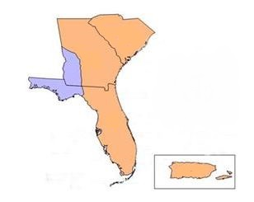
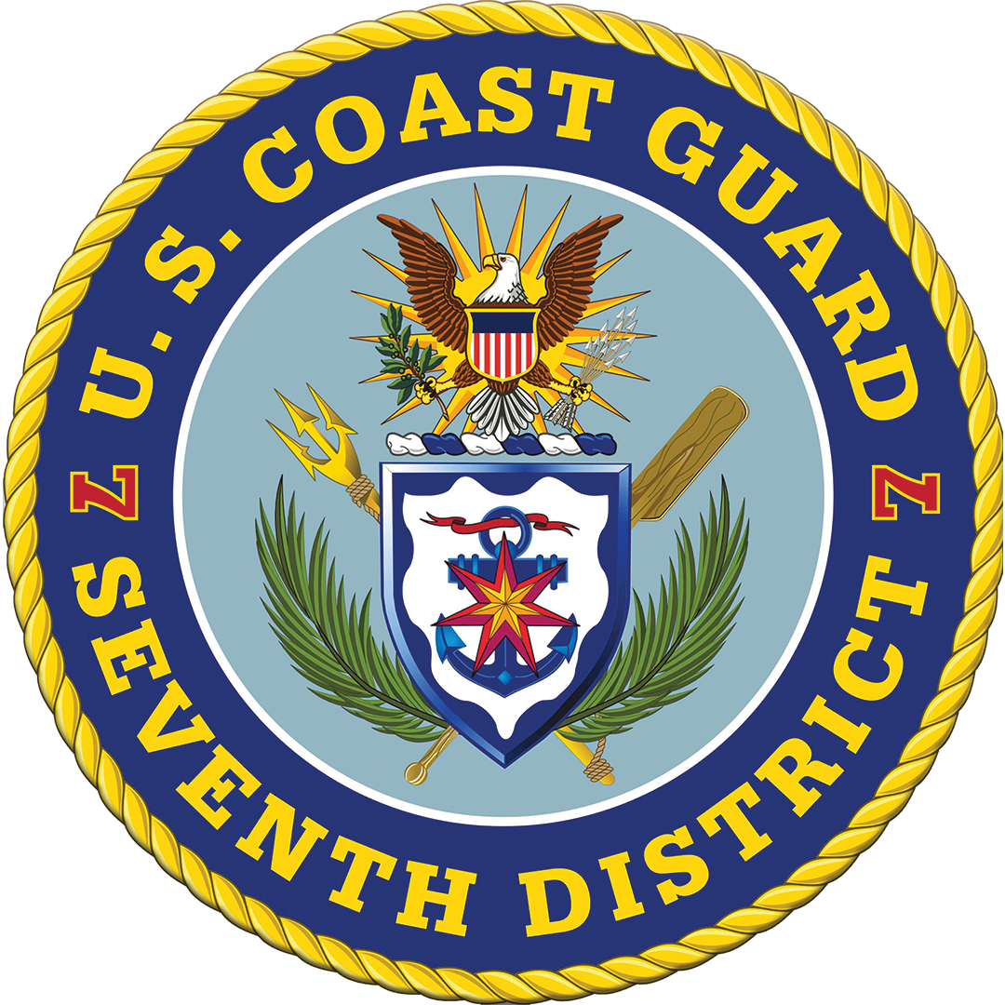
Coast Guard Seventh District
Sector Charleston
MSU Savannah
Sector Jacksonville
MSU Port Canaveral
Sector Miami
MSD Lake Worth
Sector St Petersburg
DD Ft Myers
Sector Key West
Sector San Juan
MSD St Thomas
RIO St Croix

Slide 2
D7 Fisheries
Shrimp
Crab
Spiny Lobster
Swordfish
Mackerel
Reef / bottom
Grouper
Jack
Sea bass
Cobia
Shellfish
Snapper
Wreckfish
Tilefish
Hogfish
Porgy
Dolphin
Wahoo
Tuna
Shark
Notes:
Pictures:
Left: A post COVID CFV exam in Sector San Juan
Right: A small 1977 FRP shrimp boat u/w in Sector Charleston

Slide 3
FV District Coordinator Report
CFV population 7612 (5750 State / 1838 Documented)
CFV losses 8 - CY23; 0 - CY24 to date
CFV fatalities 7 - CY23; 1 - CY24 to date
CFV injuries 9 - CY23; 2 - CY24 to date
Dockside Exams completed 448 - CY23; 77 - CY24 to date
CFVS Decals Issued 260 – CY23; 41 – CY24 to date
CFV Terminations 13 - CY23; 2 – CY24 to date
CFV Boardings 198 – CY23; 70 – CY24 to date

Slide 4
FV District Coordinator Report
Top 3 Violations
Lifesaving (PFDs, liferings, liferafts, VDS)
Communications (EPIRB, sound producing device)
Documentation (placards, COD, State registration)
2 injury(ies)
Laceration
Dive injury
1 Fatality (ies)
Overboard

Slide 5
Outreach initiatives - Unit training for Stations/Cutters, AMSEA trainings, Dockwalking
District priorities -CFVs >3 NM mandatory exam requirement, Aging CFV fleet, Consistent regulatory enforcement
District sponsored fishing industry expos, forums, meetings - SAFMC, NCFSAC, Third Party Organization Audits, AMSEA
Public website: www.dco.uscg.mil/fishsafe

